Slide 1


Slide 2

Why Conv-nets for images?
Fully connected layers won’t work well because of:
Parameter explosion: billions of weights necessary
No sense of location-based information in images
Relevant
Irrelevant
w1* +w2* +w3* +w4* +w5* +w6* + ... =

Slide 3
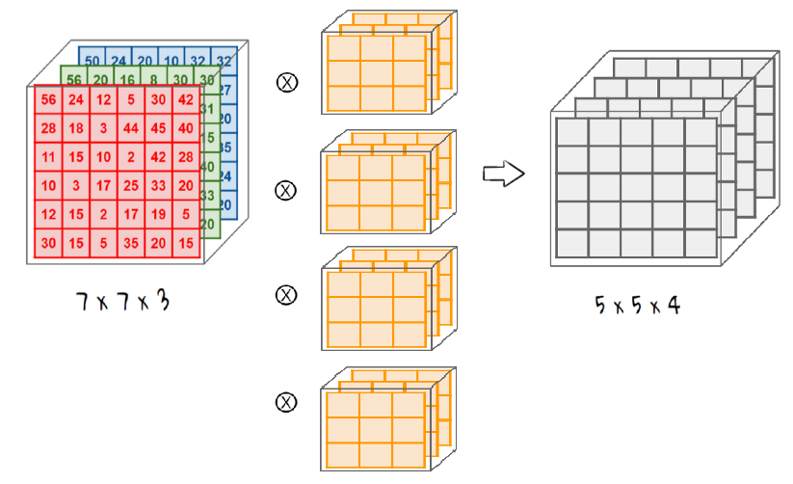
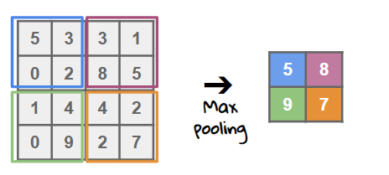

Solution: Convolute, Pool, Classify

Slide 4
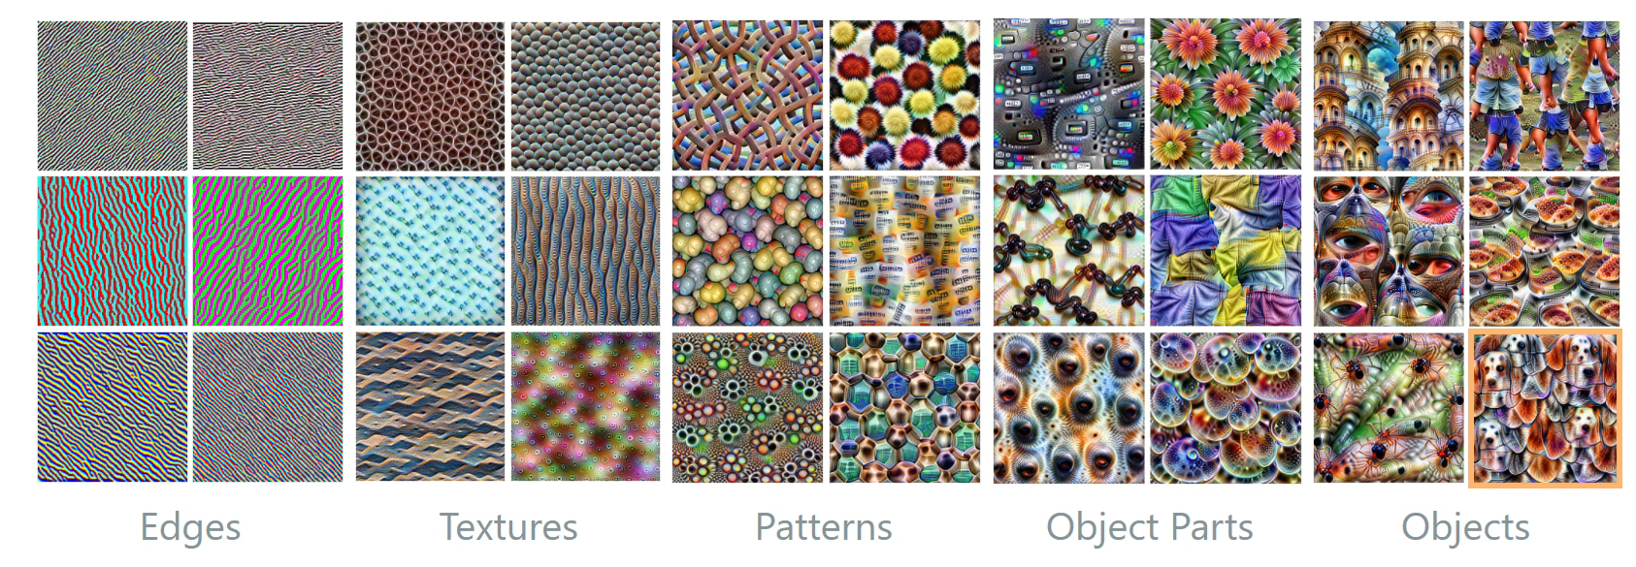
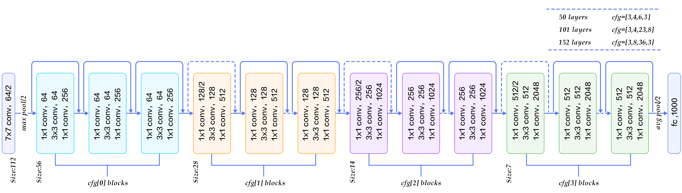
Transfer Learning
>100,000 images
Hundreds of classes
Trained network as starting point
Replace ”head” for your use-case
Specialized hardware
Your laptop’s GPU
250 images
5 classes
Lock early layers
Train final layers

Slide 5
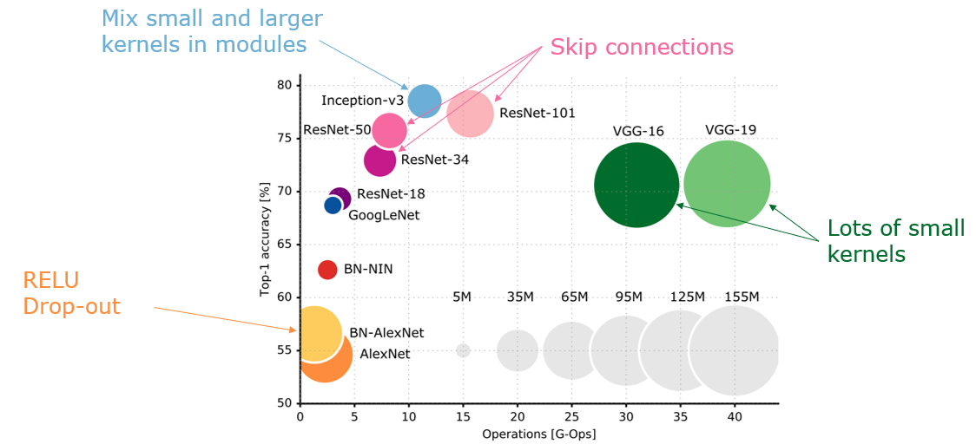
Base Models & Innovations

Slide 6
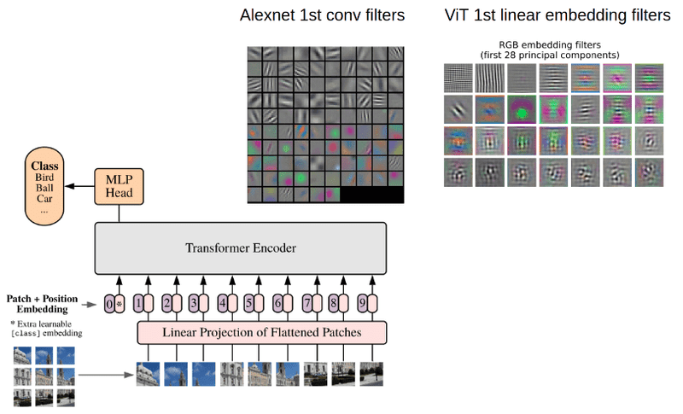
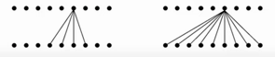
But…CNNs are localized…Enter: ViT!
Convolution uses local window (receptive field), and thus lacks global understanding
Enter: Transformers with the attention mechanism!
Convolution: local view Attention: global view → ViT!

Slide 7
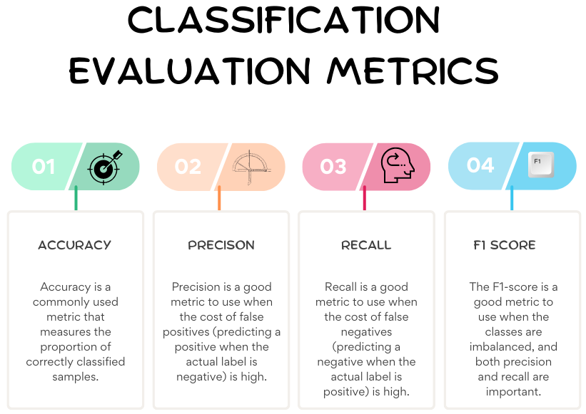
Notes:
Examples When Precision is Important (High Cost of False Positives)
Spam Detection: In email filtering, marking a legitimate email as spam (false positive) can cause important communications to be missed.
Medical Diagnosis: In cancer screening, a false positive can lead to unnecessary stress, invasive procedures, and treatments for patients.
Fraud Detection: In financial transactions, falsely flagging a legitimate transaction as fraudulent can inconvenience customers and damage trust.
Autonomous Vehicles: In obstacle detection, a false positive (detecting an obstacle that isn’t there) can cause unnecessary stops or dangerous maneuvers.
Examples When Recall is Important (High Cost of False Negatives)
Disease Outbreak Detection: Missing a case of a contagious disease (false negative) can lead to an uncontrolled outbreak.
Security Screening: In airport security, failing to detect a threat (false negative) can have severe safety implications.
Customer Churn Prediction: In business, failing to identify a customer who is likely to leave (false negative) can result in lost revenue.
Search Engines: In information retrieval, not retrieving relevant documents (false negatives) can lead to incomplete or unsatisfactory search results.

Slide 8
Evaluating Classification Models Summary
Unbalanced dataset
Use the PR curve
Focuses on the positive class, which might be rare in the dataset
Single metric: F1-score (balance point between P and R)
Single ‘area’ metric: AUC-PR, or AP
Balanced dataset
Use the ROC curve
Provides a broad and balanced performance overview, comparing True Positive Rate versus False Positive Rate
Single ‘area’ metric: AUC-ROC

Slide 9
Machine Learning
Computer Vision
Object Detection & Segmentation

Slide 10

Lesson Goals
(Students will be able to explain historical methods of object detection, such as naïve template matching, HOG features, and SIFT, and identify the limitations of those methods.)
Students will comprehend modern object detection approaches that use CNNs for feature extraction and understand the roles of regression and classification heads in these networks.
Students will be able to discuss the challenges of aspect ratio, scale and occlusion in object detection and explain how Regions-Of-Interest (ROI) identification and Non-Maximum Suppression (NMS) help address these issues.
Students will understand the differences between two-stage detectors (e.g., R-CNN family) and one-stage detectors (e.g., YOLO).
Students will be able to use metrics such as Intersection-over-Union (IoU) and mean Average Precision (mAP) to evaluate the performance of object detection models.
Students will be able to distinguish between object detection and semantic/instance segmentation, recognizing that segmentation requires pixel-level classification and the generation of spatially precise masks using techniques such as upsampling and deconvolution.

Slide 11
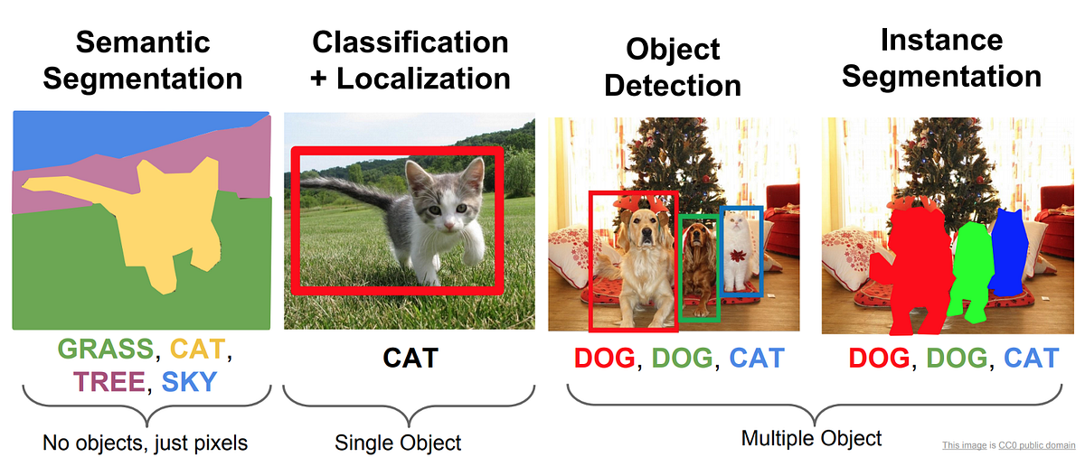
Common CV tasks

Slide 12
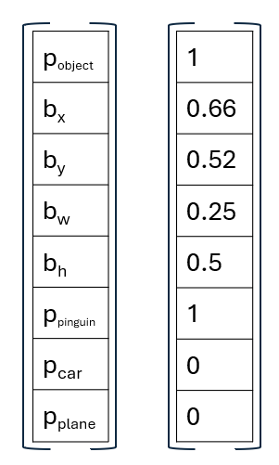
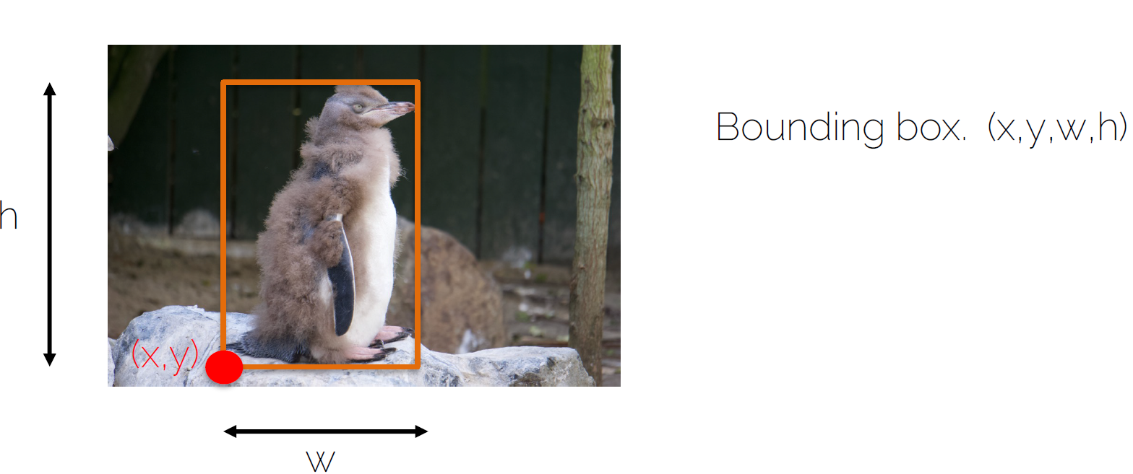
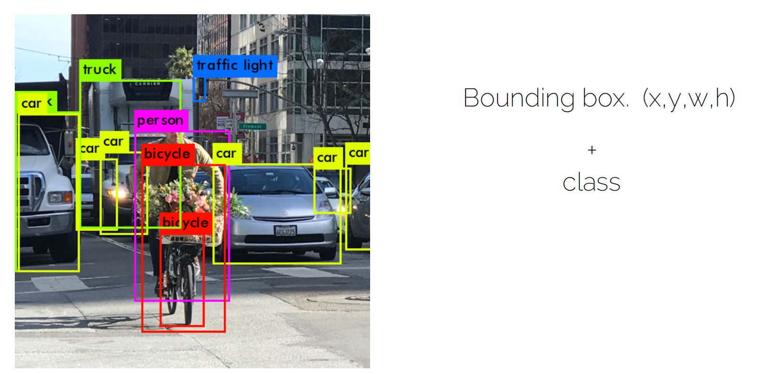
Object Detection – Task definition
First, detect possible objects in image (localize by bounding box), next classify them. Eventually: do it for multiple objects.
Notes:
https://dvl.in.tum.de/slides/cv3dst-ss20/
P object → probability that there is an object in the box

Slide 13
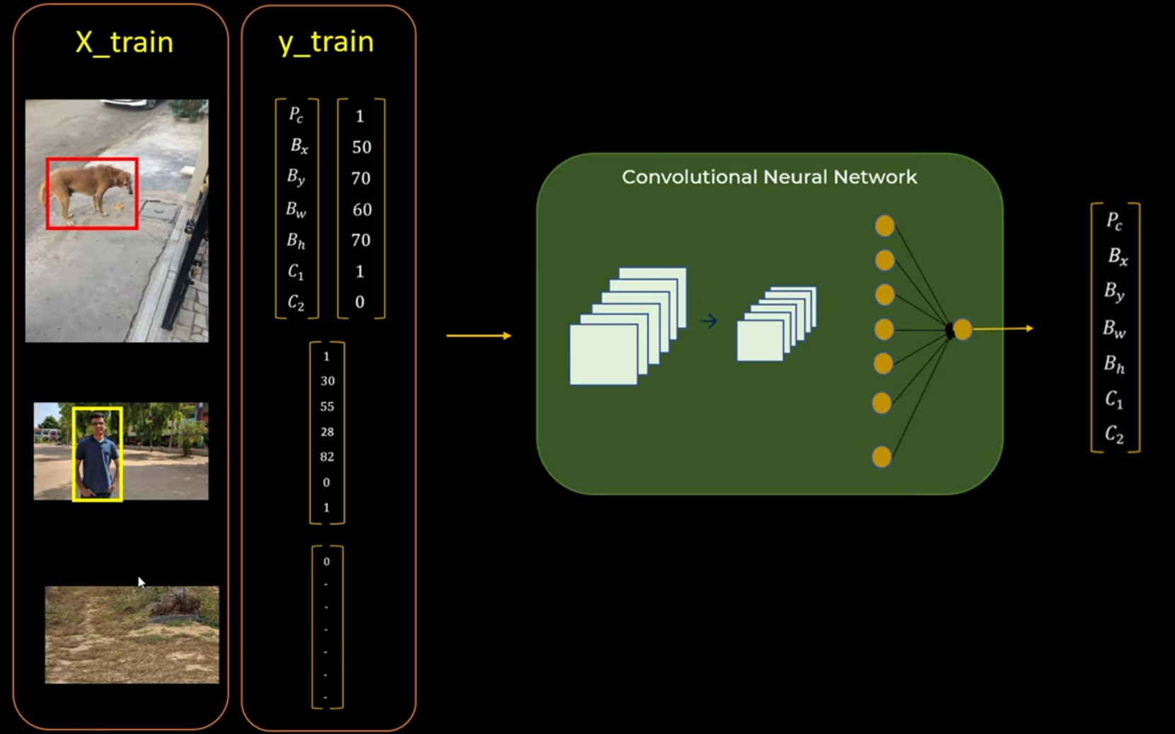
General idea: Object Detection Example with two object classes (& background)
Object 1
Object 2
Background
Notes:
https://www.youtube.com/watch?v=ag3DLKsl2vk&t=135s

Slide 14

Traditional Computer
Vision way
No Deep Learning (yet)
Notes:
One of the best resources on the history of object detection: https://www.youtube.com/watch?v=s3LYS9K5Nik&list=PLH5_eZVldmtWFmiD_JE3c3yTBKo9OwuQq&index=13&ab_channel=MachineLearningCenter

Slide 15
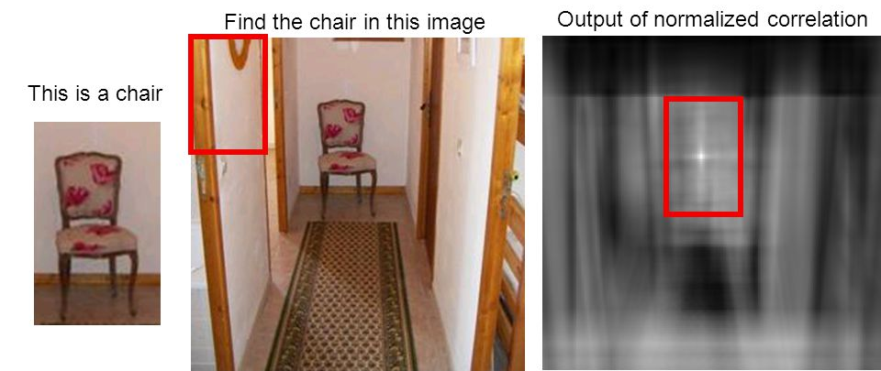
Naïve: Template matching Sliding Window + correlation calculation

Slide 16
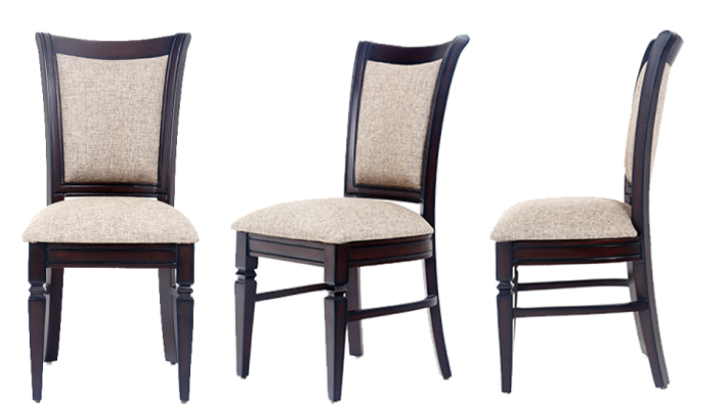
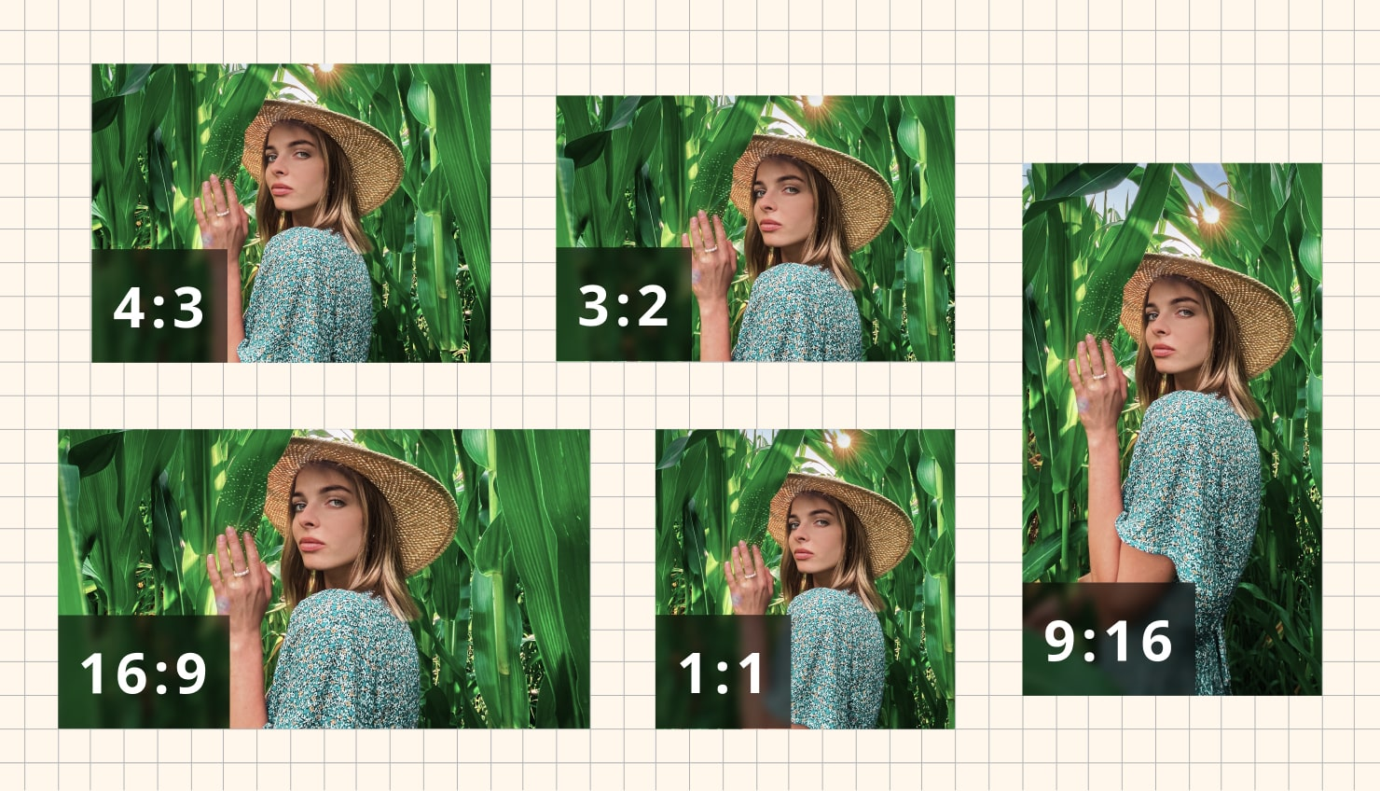
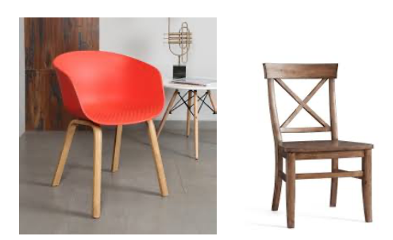
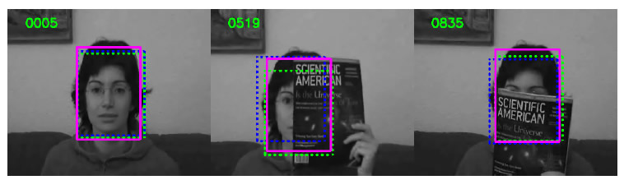
Issues of naïve template matching
Naïve pattern matching by using a pattern, has a couple of issues:
Occlusions issues
Pose / orientation issues
In general:
Scale and aspect ratio issues → go for pyramid approach
Pattern is too specific, not general enough → go for feature extraction
?
?
?
?

Slide 17
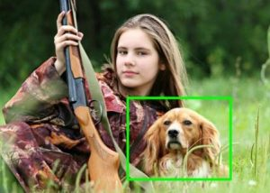
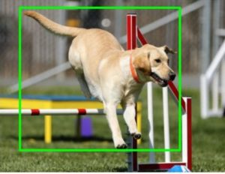
Scale & Ratio Challenge + compute of Sliding Windows
Scale and Aspect Ratio:
Handling objects of different scales and aspect ratios was challenging.
Computationally Expensive:
Scanning the entire image with multiple windows of different sizes and aspect ratios is very slow.

Slide 18
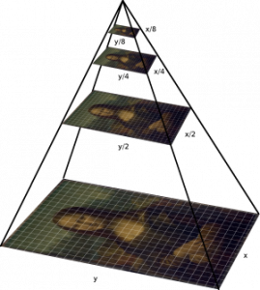
Pyramid Approach
To address the issue of scale, the pyramid approach was introduced:
Image Pyramid: image was resized to multiple scales, creating a pyramid of images.
Sliding Window on Each Scale (Octave): sliding window technique was applied to each level of the pyramid.
Combining Results: results from different scales were combined to detect objects of various sizes.
This approach helped in detecting objects at different scales but was still computationally intensive.

Slide 19
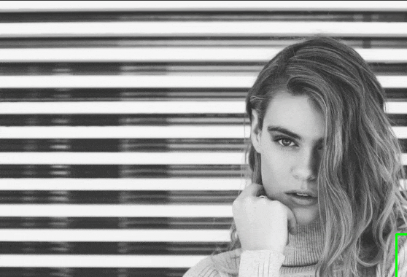
Next: Feature extraction + classification Sliding Window of Fixed Size
Exact pattern was too specific → need for general feature extraction and matching, instead of correlation
Fixed-Size Windows: scan using different fixed-size windows
Feature Extraction: get feature vector of each window, by hardcoded features, or by using calculated features, like HOG (Histogram of Oriented Gradients) or SIFT
Classification: classify each window vector, and use probability score to detect possible objects

Slide 20
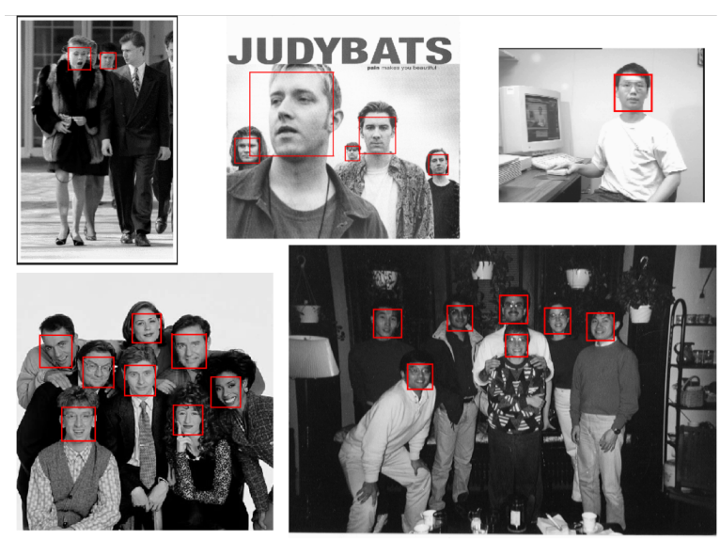
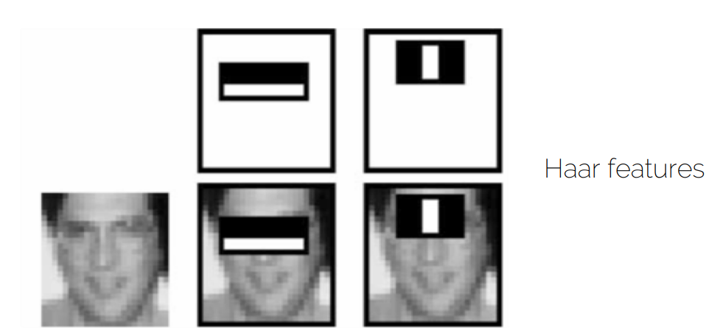
Feature extraction
‘Hard-coded’ features, like Haar features (Viola-Jones detector)
Calculated features, like HOG or SIFT

Slide 21
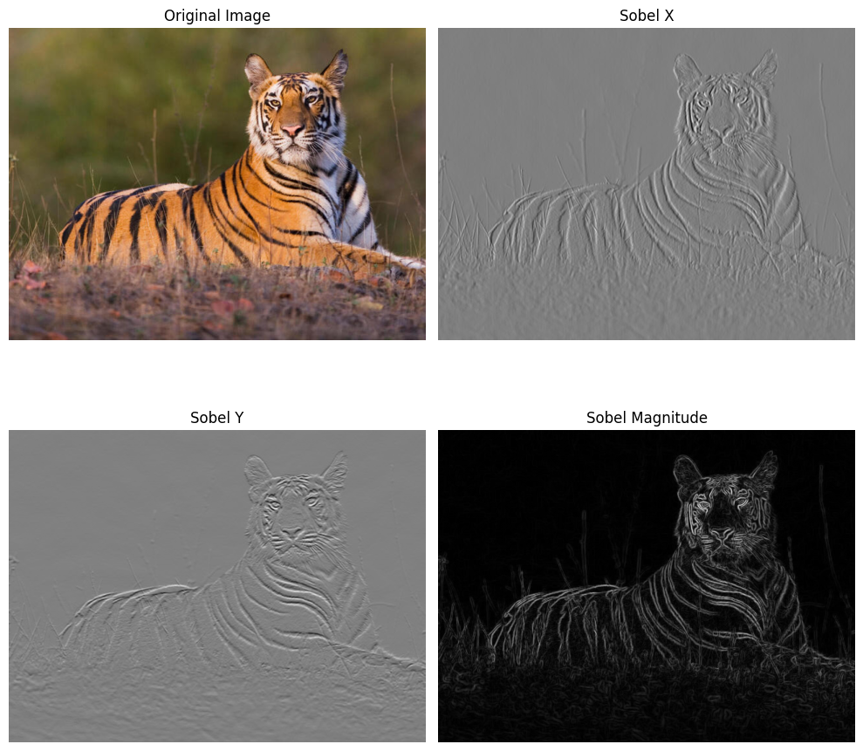
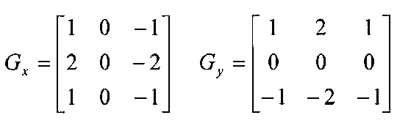
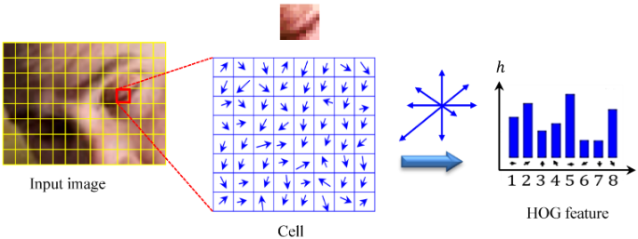
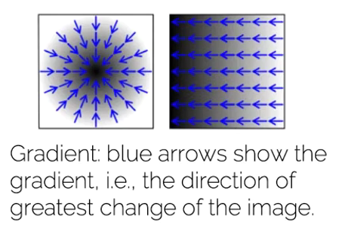
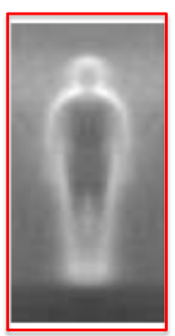
Histogram of Oriented Gradients (HOG)
Feature engineering technique on images (pre-CNN)
Based on horizontal and vertical Sobel Edge Detectors
Calculate HOG features on the sliding windows → send to classification model (like SVM). Gradients provide shape information.

Slide 22
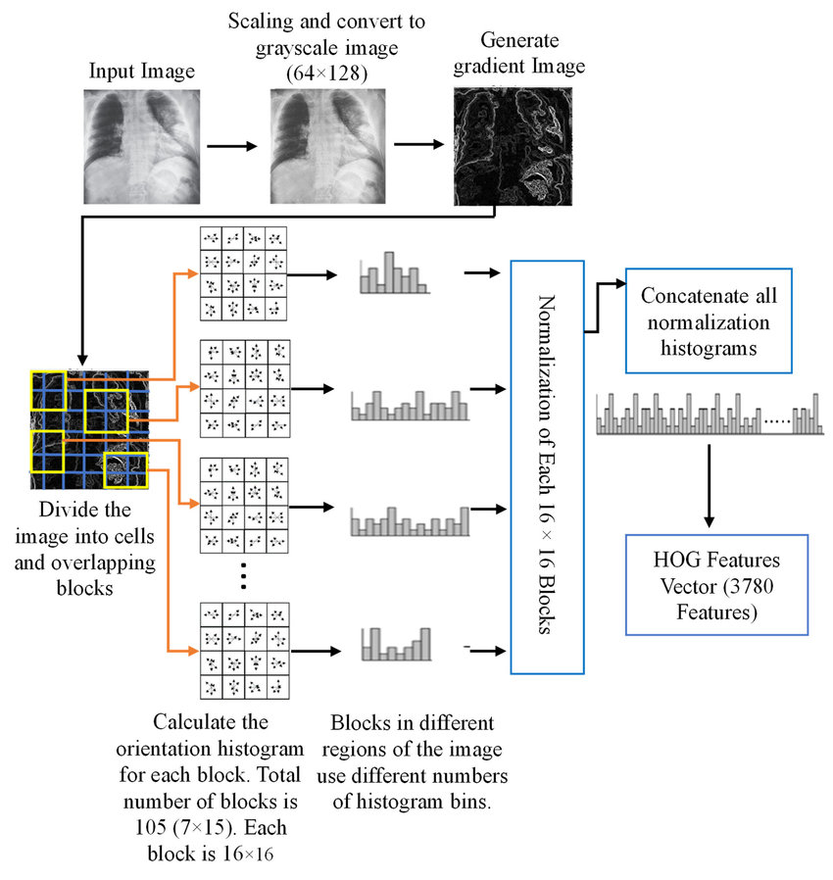
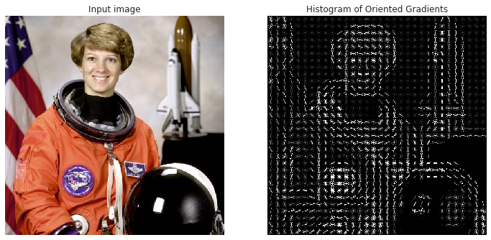
HOG Feature Engineering
Turn each window / image → vector

Slide 23
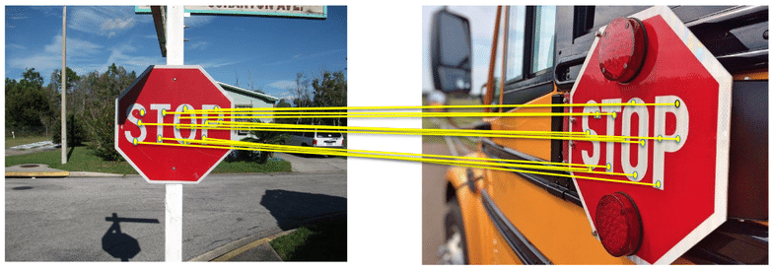
SIFT – David Lowe 1999 (Scale-Invariant Feature Transform)
Notes:
https://en.wikipedia.org/wiki/Scale-invariant_feature_transform

Slide 24
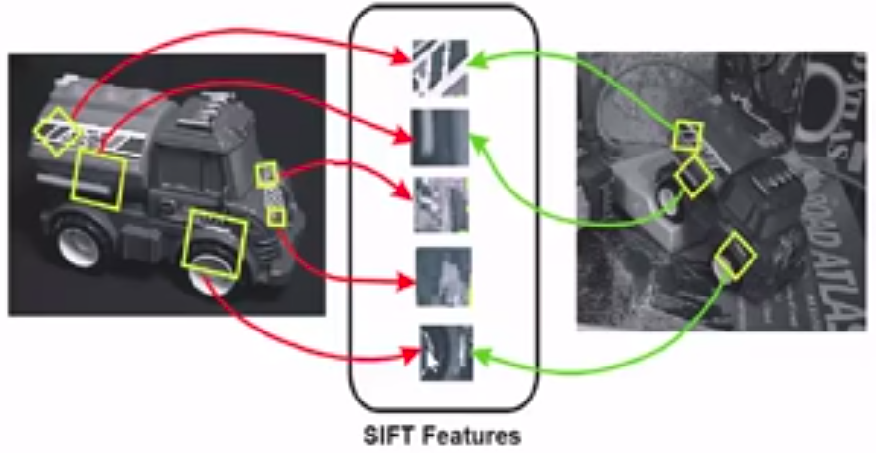
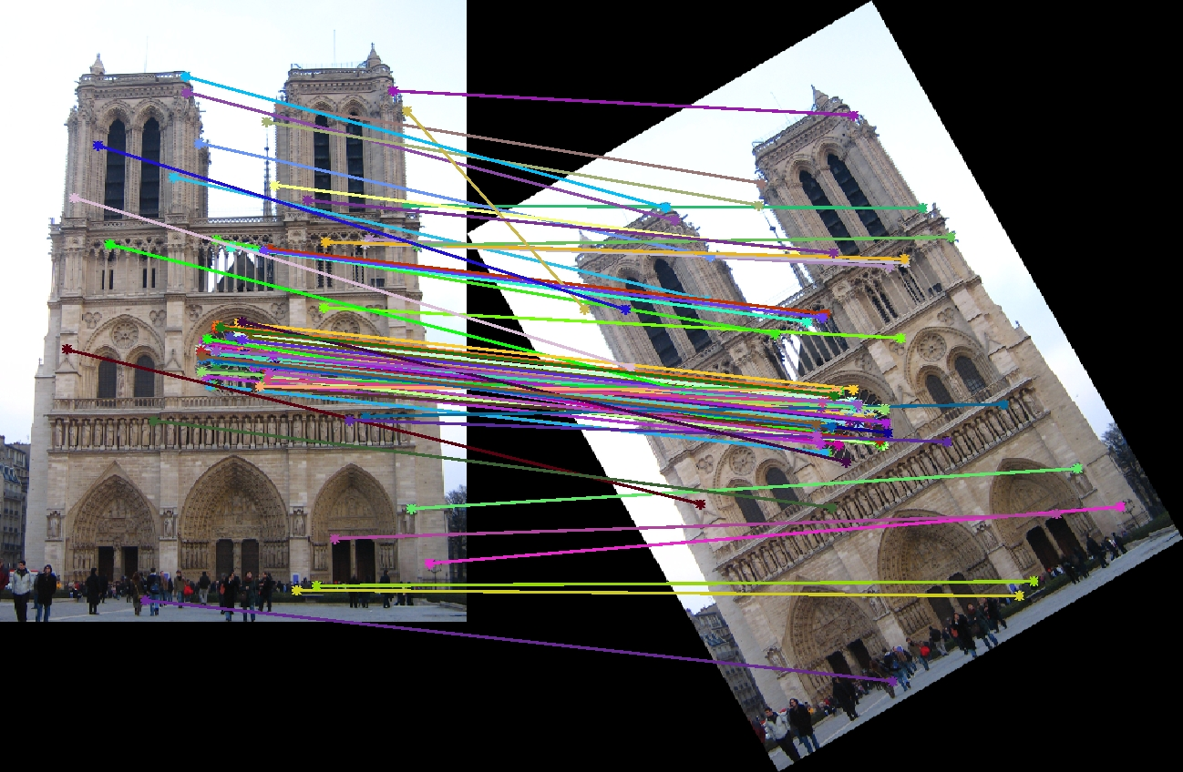
SIFT Feature Engineering (Scale-Invariant Feature Transform)
SIFT = Enhancement over HOG features, which vectorizes entire image
Key idea:
Identify keypoints in image (independent of scale, translation, rotation)
Vectorize small patch around the keypoints via HOG, and combine
Unlike HOG, which processes the entire image patch, SIFT extracts features only from the keypoints, making it more robust to changes in scale and rotation.

Slide 25
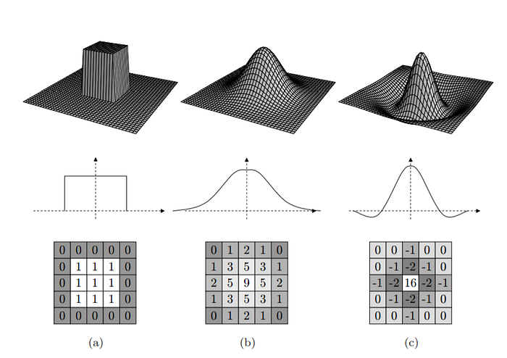
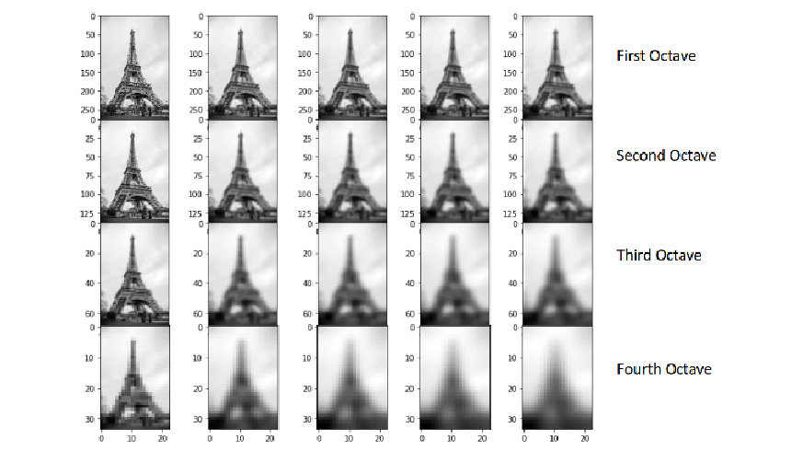
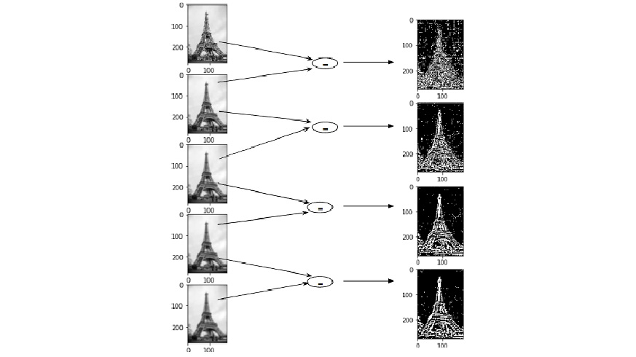
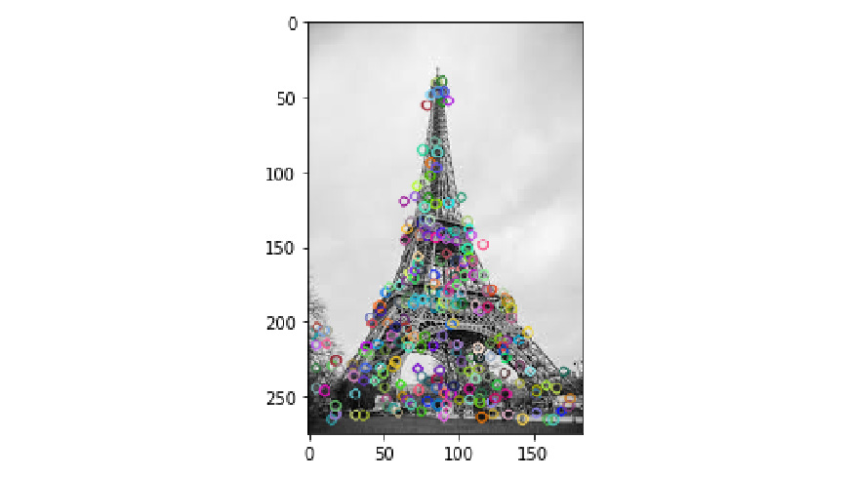
SIFT Keypoints
Use Image Pyramid (Octaves)
By resizing the image to create a pyramid of images at different scales, we achieve scale invariance. This allows the detection of keypoints that remain stable regardless of the image size.
Subtract different Levels of Gaussian Blur
Apply Gaussian blur at various levels, then subtract two consecutive levels to create Difference of Gaussians (DoG) images.
Identify extrema (max or min) candidates in these DoG images, as these points represent where the gradient changes the most.
Detect extrema points as candidates for keypoints
Notes:
https://www.analyticsvidhya.com/blog/2019/10/detailed-guide-powerful-sift-technique-image-matching-python/
Image Pyramid (Octaves)
By resizing the image to create a pyramid of images at different scales, we achieve scale invariance. This allows the detection of keypoints that remain stable regardless of the image size.
Subtract different Levels of Gaussian Blur
Apply Gaussian blur at various levels, then subtract two consecutive levels to create Difference of Gaussians (DoG) images.
Identify extrema (max or min) candidates in these DoG images, as these points represent where the gradient changes the most.
Idea is to detect keypoints that are invariant to the level of detail in the original image. This helps in identifying features that are consistent across different resolutions.
Imagine stacking layers of the same image, each one more blurred than the last — that’s a scale-space. Then imagine shrinking the image and repeating the process — that’s the next octave.

Slide 26
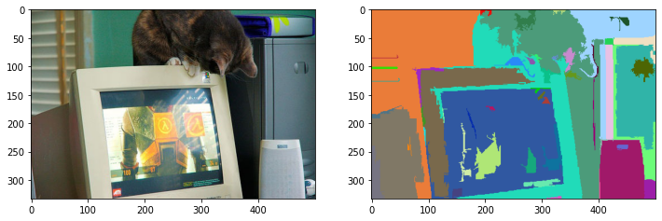
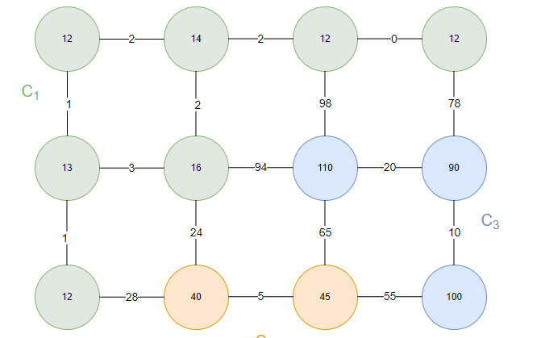
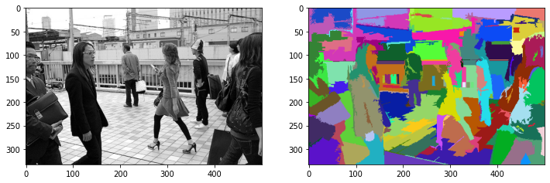
Image Segmentation & ROI (Region of Interest)
Felzenszwalb & Huttenlocher (2004): Graph based approach to images
Each pixel is a node, and the edges get a weight based on the dissimilarity between the 2 pixels
‘Cluster’ pixels together which have small internal difference, to form segments
Foundational technique for segmentation, but also to select Regions of Interest (ROI)
Notes:
https://soumik12345.github.io/geekyrakshit-blog/algebra/computervision/convolution/maths/python/2020/09/17/efficient-graph-based-image-segmentation.html

Slide 27

New Insights
Go for Deep Learning!
Use CNN as feature extractor!
Notes:
One of the best resources on the history of object detection: https://www.youtube.com/watch?v=s3LYS9K5Nik&list=PLH5_eZVldmtWFmiD_JE3c3yTBKo9OwuQq&index=13&ab_channel=MachineLearningCenter

Slide 28

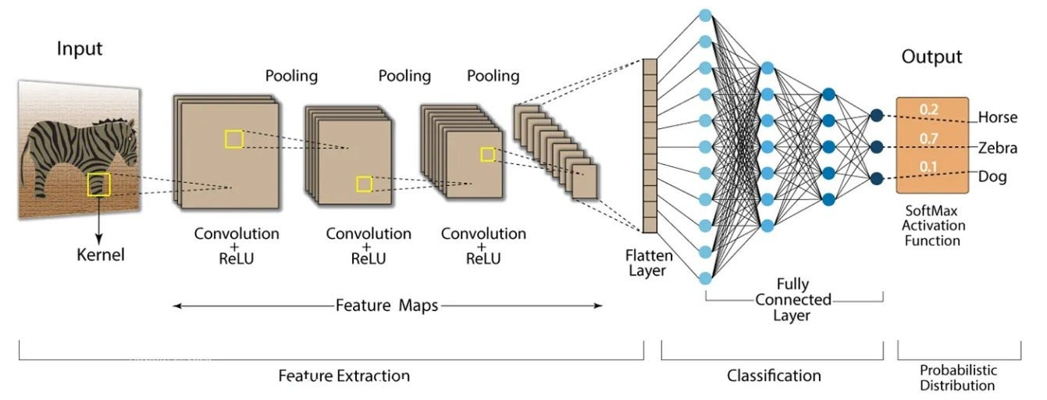
Convolutional Neural Network as Feature Extractor (learned by data)
Convolutional Neural Network:
Sliding window technique!
Learns features by data samples, no manual feature extraction!

Slide 29

Enter… Multi-headed Networks!

Slide 30
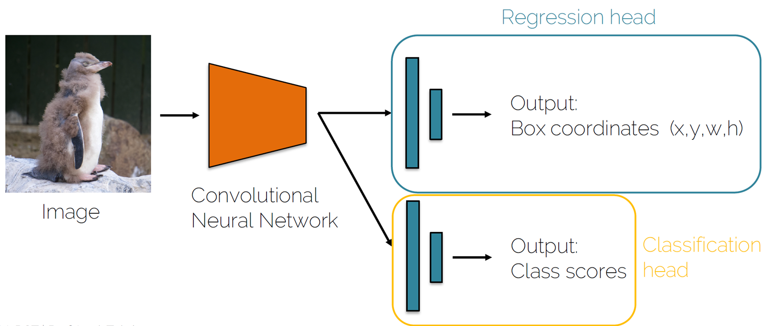
(Two headed) Object Detector Localize & classify
Each object detector has to
Localize the object – predict bounding box coordinates (regression)
Classify the object in the bounding box (or predict as background)
Fully Connected
L2 Loss ((R)MSE)
Flatten
Feature extractor
Softmax / Crossentropy Loss

Slide 31
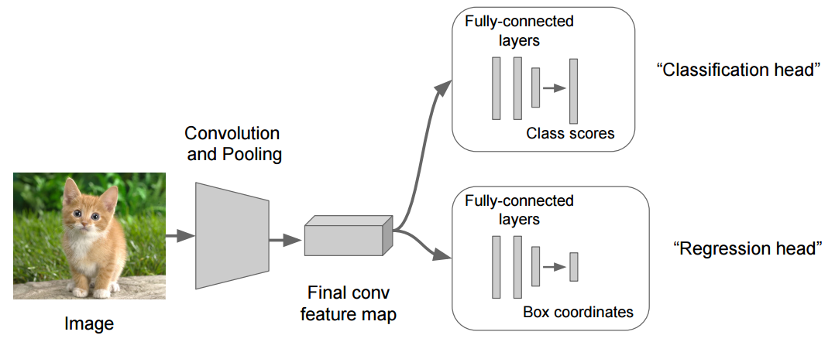
(Two-headed) Object Detector Localize & Classify
Notes:
Now we train both heads at the same time: for instance the softmax loss for classification and the L2 loss for regression: we create a balance between the 2 losses (alpha and beta for which loss is more important), and use this as our loss function to update FC and CNN layers
The combined loss is used to update the weights in both the fully connected layers of each head and the shared CNN backbone

Slide 32
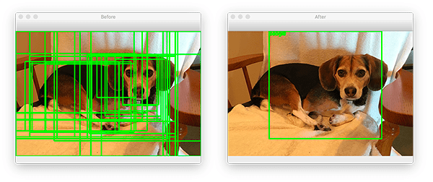
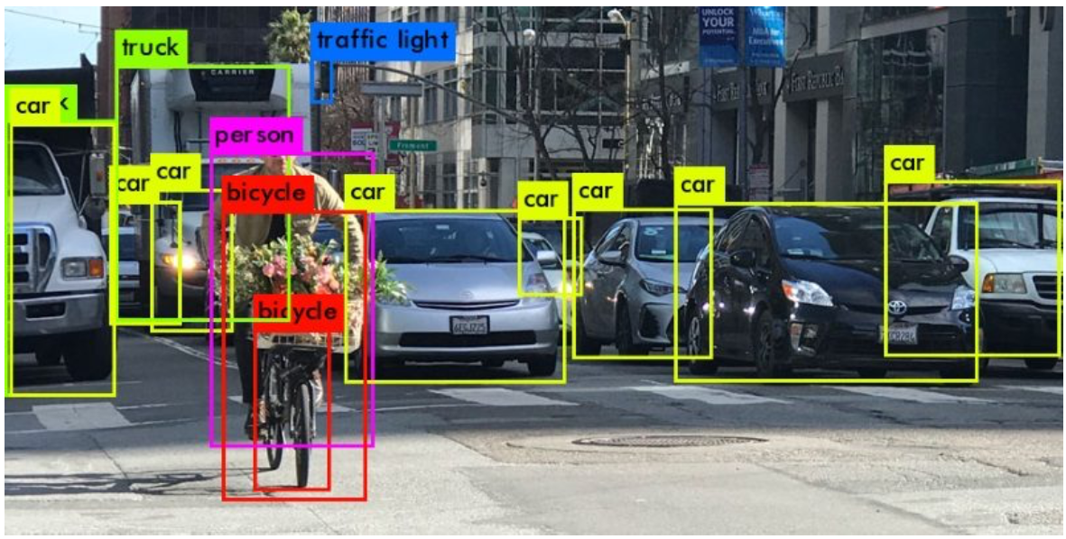
Challenges for sliding window object detectors
Lots of compute needed to test out multiple sizes and aspect ratios of sliding windows
Solution: restrict search space to ROI’s
Unknown number of objects in the image (neural network has a static number of outputs)
Solution: predict many potential bounding boxes (class-agnostic), and then refine them by classification & using non-max suppression

Slide 33
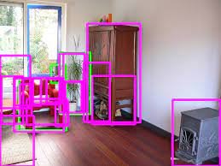
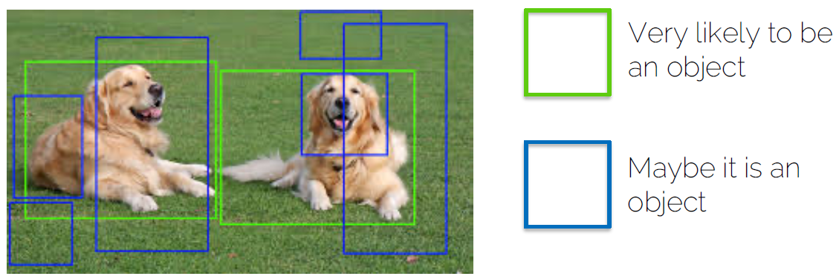
Class-Agnostic Object Detection
Class-aware object detection
recognize and classify specific objects of predefined categories (cars, cats, dogs, etc)
Class-agnostic detection
detects all possible objects in an image, even those not recognized from training data. A ‘generic’ object detector
→ focuses on the presence and location of objects, not the category
→ easily scalable to detect new categories of images, without requiring extensive labelled data for each new category
Notes:
https://dvl.in.tum.de/slides/cv3dst-ss20/

Slide 34
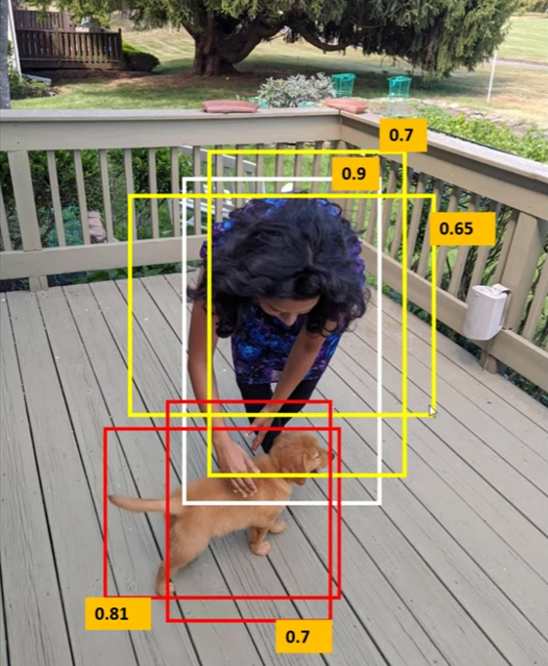
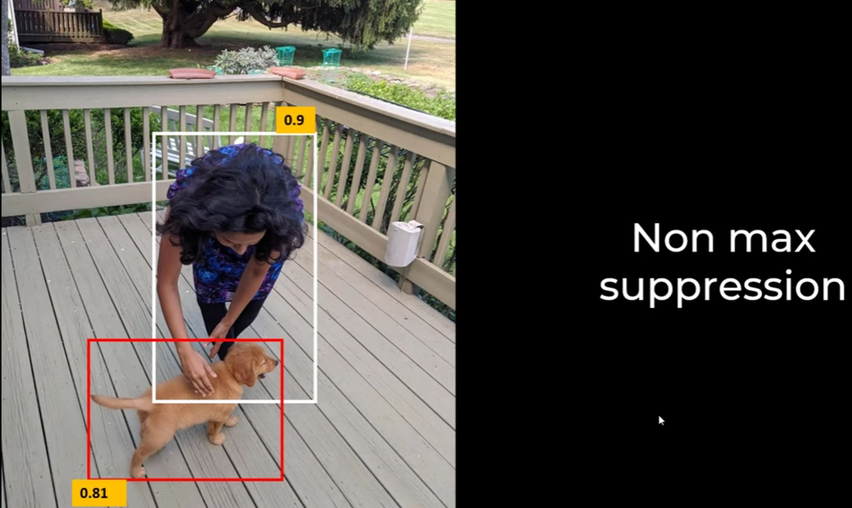
Non-max suppression (NMS) Do we want all possible boxes?
Non-Max Suppression:
A post-processing technique used in object detection to eliminate duplicate detections (using IoU), and select the most relevant detected object → only keep the best bounding box

Slide 35




Metric: IoU (Intersection of Union) (IoU = Jaccard Index)
Notes:
https://www.v7labs.com/blog/intersection-over-union-guide

Slide 36

Non-Max Suppression Algorithm (NMS)
General idea:
Select the bounding box with maximum confidence, and suppress all other boxes that overlap with this maximum box, with an overlap bigger than a threshold (IoU)
Let’s see an example:

Slide 37



Non-Max Suppression Algorithm (NMS) in action
Step1: Sort all bounding boxes, based on confidence level
Step2: Select box with highest confidence
Step3: Calculate IoU overlap with all other boxes
Step4: Remove all boxes that overlap more than a predefined threshold
Step5: Repeat

Slide 38


Non-Max Suppression Algorithm (NMS) in action
Box4 will be removed, because it overlaps too much with box1 (with this threshold setting)
Box8 will be kept, because it overlaps less then the threshold

Slide 39

Result of the NMS

Slide 40

Non-Max Suppression - Recap
Notes:
https://www.jeremyjordan.me/object-detection-one-stage/

Slide 41


Non-Max Suppression is not perfect! Difficulties with NMS-thresholding
Setting the ‘correct’ NMS threshold (IoU) is tricky…
Set it too high, and you miss occluded objects. Too low, and you might detect the same object multiple times

Slide 42
Two-stage detectors

Slide 43


Object Detector - Main approaches
ROI + Refine
Do it all in one shot

Slide 44

It started with two-stage detectors
Notes:
https://www.youtube.com/watch?v=018ZES5x0t8&ab_channel=BendingSpoons

Slide 45


Slide 46


Region-based CNN (R-CNN) R. Girshick 2013
Instead of HOG features → use a CNN to classify object!
Instead of SIFT key points → use segmentation to identify possible object regions!
R-CNN: Selective Search (identify possible object regions):
Initial sub segmentation
Greedy algorithm to combine similar sets of regions, repeat
Use final segmented region proposals to generate candidate object locations →2k!

Slide 47

R-CNN Overview
Uses SVM
Classification Challenge:
Selective Search produces 2,000 region proposals, that have to go through the CNN → bottleneck in 2013, so leave the classification to separate SVM
Localization Challenge:
Region proposals are not very accurate bounding boxes, so a separate Dense layer was added and trained on bounding box coordinates from true labels to refine them (bounding box regression)
Notes:
https://www.geeksforgeeks.org/r-cnn-region-based-cnns/
https://www.geeksforgeeks.org/r-cnn-vs-fast-r-cnn-vs-faster-r-cnn-ml/

Slide 48


R-CNN Bounding Box Regressor

Slide 49
Training R-CNN
Ground Truth Labels
You provide the ground truth bounding boxes and labels for each object in your training images.
Region Proposals
Selective search generates a set of region proposals for each image.
IoU Calculation
The algorithm calculates the Intersection over Union (IoU) between each region proposal and the ground truth bounding boxes.
Classification of Samples:
Positive Samples:
Region proposals with an IoU above a certain threshold (e.g., 0.5) with any ground truth box are considered positive samples.
These are used to train the model to recognize your objects.
Negative Samples:
Region proposals with an IoU below a lower threshold (e.g., 0.3) with all ground truth boxes are considered negative samples.
These are used to train the model to recognize background or non-object regions.
Both positive and negative samples are used during training. Negative samples are crucial as they help the model learn to distinguish between objects and background, reducing false positives

Slide 50

R-CNN Evolution: Fast R-CNN, Faster R-CNN
Each evolution brought a more efficient region proposal algorithm, enhancing both speed and accuracy
Difference: how to apply the CNN!
Anchor Boxes
Notes:
R-CNN: First generates region proposals using Selective Search, then applies a CNN to each region proposal individually for classification and localization.
Fast R-CNN: Improves efficiency by applying a CNN to the entire image first to generate feature maps, then uses these feature maps for both region proposal and classification/localization.
Faster R-CNN: Further enhances the process by introducing the Region Proposal Network (RPN), which generates region proposals directly from the feature maps produced by the CNN backbone, making the region proposal step nearly cost-free.

Slide 51

Faster R-CNN Anchor Boxes & ROI Pooling
Anchor boxes
ROI pooling:
Only select top scoring ROI’s
Does anchor contain object or not?
Warping to standard size

Slide 52

Anchor Box (Faster R-CNN, Yolo)
CNN network proposes regions of interests (ROI’s)
Use Anchor Boxes (reference boxes) of predetermined size and aspect ratio to best match the proposed ROI (using IoU)
Deals with the size and aspect ratio issue of object detection
More efficient training, no need to dynamically adjust bounding box

Slide 53

Anchor Box Regression

Slide 54

R-CNN Evolution
Notes:
Beste resource: Faster R-CNN Explained for Object Detection Tasks | Paperspace Blog

Slide 55

Benefits of two-stage detectors
?

Slide 56

One-stage detectors

Slide 57
Object Detector - Main approaches
ROI + Refine
Do it all in one shot

Slide 58

Notes:
the model divides the image into a grid and, for each grid cell, predicts multiple bounding boxes based on predefined anchor shapes. These anchor boxes act as implicit region proposals, and the model learns to adjust their coordinates and assign object classes directly — all in one forward pass.

Slide 59


YOLO: You Only Look Once The most famous object detector!
Divide the image into a grid, typically 13x13 or 16x16 cells (or finer grids)
Each cell is responsible for predicting a fixed set of bounding / anchor boxes and their confidence scores (using the power of CNN)
Non-maximum suppression (NMS) is used to handle multiple detections of same object

Slide 60

Here 4x4 grid (usually 13x13), each grid predicts bounding box (7 numbers, if you have 2 classes of objects)

Slide 61


Slide 62
Use of NMS to handle multiple boxes that cover the same object

Slide 63

Use of 9 Anchor boxes to handle multiple scales/ratio & multiple objects
Each cell predicts 9 different anchor boxes, so they can focus on multiple scales/ratios & theoretically detect 9 different objects
Example with 2:

Slide 64

Yolo: Putting it all together

Slide 65

Challenge for one-stage detectors Imbalance foreground-background
Two-stage detectors:
Use ROI’s to pinpoint where to look (interesting foreground regions)
Accurate & great for small objects, but slow
One-stage detectors:
Look everywhere, all at once, but there are many background anchors, and only a few foreground anchors!
Fast (real-time), but less accurate, especially for small objects
Notes:
Optimization (RetinaNet-2017):
tweak the loss function (focal loss): learn more from the hard foreground samples, and less from the many many easy background samples
Use ResNet as a backbone CNN

Slide 66
Object Detection
Model Evaluation

Slide 67

Model Evaluation How good is this model?
Notes:
https://www.v7labs.com/blog/mean-average-precision

Slide 68

Evaluating Classification Models Precision & Recall
Confusion Matrix, because accuracy is too limited
Precision (positive predictive value): describes how well a model predicts the positive class. Priority on ‘correctness’.
Recall (sensitivity) tells you if your model made the right predictions when it should have. Priority on ‘completeness’.
Notes:
https://www.v7labs.com/blog/mean-average-precision

Slide 69


Precision – Recall Curve
Plotting the Precision-Recall values at different probability thresholds
→ Precision-Recall Curve!
With this curve, we can:
Identify the optimal threshold that balances precision and recall for our use case
Understand how changes in the threshold affect the model’s performance.
Compare the performance of different models or configurations.
Notes:
https://www.datacamp.com/tutorial/precision-recall-curve-tutorial

Slide 70



Capture PR Curve into one single metric
Different ‘aggregate’ ways to summarize the info of the PR curve into one number
F1 Score
Represents a single point on the precision-recall curve, balancing precision and recall at a specific threshold.
PR-AUC (Area Under the Curve):
Measures the entire area under the PR curve, using all points to evaluate the model’s overall ability to distinguish between classes.
Integrates the area under the curve = exact area measurement
Average Precision (AP):
Averages precision across several recall levels and averages them, using step function.
Estimate of the area under the curve

Slide 71
mAP = combining AP + IoU (and/or, averaging over multiple object classes)
On one hand: Average Precision (AP) thresholding
Balancing Precision versus Recall, using different probability thresholds
On the other hand: Intersection-Over-Union (IoU) thresholding
Different IoU thresholds will determine if a predicted bounding box is considered a true positive, or not (based on the overlap with the ground truth)
‘Spatial Accuracy’
Combining both thresholds into one:
enter Mean Average Precision (mAP50-95)
Notes:
mAP50: set the IoU overlap to 50%, but it’s still a mean AP, because it averages out over different object classes.
mAP50-95: average out over different levels of IoU (going to 95% overlap, which is very strict) (and possibly over multiple object classes)

Slide 72

Overview: mAP50 vs mAP50-95

Slide 73

Metric: mAP (mean Average Precision) Evaluation of model performance
mAP is based on different levels of IoU, combined with AP!
Different IoU thresholds will produce different scores for confusion matrix, because they define what’s positive or what’s negative
True Positive (TP): object predicted, covers ground label suffiently
False Positive (FP): object predicted, but doesn’t reach the IoU threshold or wrong class
True Negative (TN): no object predicted, no object present
False Negative (FN): no object predicted, but there was one!
→ Combine with confidence score to get Precision-Recall curve, and AP
Notes:
https://www.v7labs.com/blog/mean-average-precision

Slide 74

Metric: mAP (mean Average Precision) Evaluation of model performance
mAP helps in evaluating the performance of the object detection model across different levels of strictness in terms of overlap between predicted and ground truth bounding boxes.
Set the IoU to a specific threshold (e.g., 0.5).
Calculate the Average Precision (AP) for that IoU threshold.
Change the IoU threshold to another value (e.g., 0.75).
Calculate the AP for this new IoU threshold.
Repeat this process for several IoU thresholds (e.g., 0.5, 0.55, 0.6, …, 0.95).
Compute the mean of all AP values to get the mean Average Precision (mAP).
Red: mAP for IoU > 0,9 (90%)
Yellow: mAP for IoU > 0,1 (10%)
Calculate AP for each of these curves, and take mean = mAP
Notes:
https://www.v7labs.com/blog/mean-average-precision
mAP50: set the iou at 50%, and take the mean over all different object classes
mAP50-95 is also averaging out over the different levels of IoU, so a lot stricter

Slide 75


Slide 76
Benchmarks &
Data Formats

Slide 77

Important Benchmarks
PASCAL VOC (Visual Object Classes)
ImageNet (only has classification labels, no bounding boxes nor segmentation masks)
MS COCO (Microsoft Common Objects in Context)
LVIS (Large Vocabulary Instance Segmentation)

Slide 78


Benchmark Datasets

Slide 79


Slide 80


Slide 81

Notes:
https://www.youtube.com/watch?app=desktop&v=h6s61a_pqfM&ab_channel=ImmersiveLimit

Slide 82
Computer Vision
Segmentation

Slide 83
Common CV tasks

Slide 84


Slide 85

Fully Convolutional Networks (FCNs) - 2015
Replaced the fully connected layers in a CNN, with (de-)convolutional layers (upsampling), to output spatial maps

Slide 86

U-Net
Transfer/enable spatial information, by:
Skip connections !
Transfer high-resolution features from the encoder to the decoder to retain fine spatial details
Up-conv !
Restore the spatial resolution lost during downsampling
Notes:
https://fritz.ai/deep-learning-for-image-segmentation-u-net-architecture/

Slide 87


Convolutions ← → Up-conv
Notes:
https://fritz.ai/deep-learning-for-image-segmentation-u-net-architecture/

Slide 88


U-Net results

Slide 89

Upsampling (SegNet)
Some segmentation techniques, like SegNet, use max unpooling to reconstruct spatial information, instead of using skip connections

Slide 90

Mask (faster) R-CNN
Extend the Faster R-CNN by adding a segmentation branch, to also generate binary mask prediction

Slide 91


ViT for segmentation

Slide 92


Segment Anything Model (SAM) (from ‘Meta AI’)
SAM = ViT foundational model trained to generalize across segmentation tasks
Image encoding is the heavy lifting, and done only once
Prompts are processed quickly
Notes:
The Segment Anything Model (SAM)
Released by Meta AI in 2023, the Segment Anything Model (SAM) represents a significant leap forward in image segmentation. It is a foundation model for segmentation, meaning it can be adapted to a wide range of downstream segmentation tasks without the need for additional training.
How it works: SAM's key innovation is its promptable segmentation design. It can segment objects based on various user-provided prompts, such as:
Points: Clicking on a point to segment the object at that location.
Bounding Boxes: Drawing a box around an object.
Text: Providing a text description of the object to segment (though this is less of a primary focus of the initial model).
Masks: Providing a rough mask of an object.
Architecture: SAM's architecture consists of three main components:
Image Encoder: A powerful Vision Transformer (ViT) pre-trained on a massive dataset processes the input image and generates a high-dimensional embedding. This is computationally the most intensive part, but it only needs to be run once per image.
Prompt Encoder: This lightweight encoder converts the user's prompts (points, boxes, etc.) into embeddings.
Mask Decoder: This efficient decoder takes the image embedding and the prompt embeddings as input and predicts the segmentation mask. Because the image encoder is separate, the mask decoder can generate a new mask from a new prompt in real-time.

Slide 93


SA-1B dataset https://segment-anything.com/dataset/index.html
Notes:
Training and Data: What truly sets SAM apart is its training data. The model was trained on an enormous dataset of over 1 billion masks on 11 million images. This massive and diverse dataset allows SAM to develop a general understanding of what constitutes an object, enabling it to perform zero-shot generalization. This means it can segment objects and images it has never seen before, without needing to be fine-tuned on new data.

Slide 94
YOLOv11
Trial run

Slide 95


SOTA Computer Vision YOLOv11 (Ultralytics)
Yolo v11: unified model / multi-task learning model!
Notes:
https://leaderboard.roboflow.com/?ref=blog.roboflow.com

Slide 96

Try it out in code: Our own image

Slide 97

Yolov11 Out of the box: Object Detection

Slide 98

Settings: Confidence: 0,5 - IoU: 0,5

Slide 99

Out of the box: Segmentation

Slide 100

Out of the box: Pose Model

Slide 101




Let’s go custom Data Labelling…

Slide 102


Let’s go custom Training…
Box regression, classification loss, focal loss (see retinanet)

Slide 103

Quick result: custom training

Slide 104



Over to you

